Slide 1

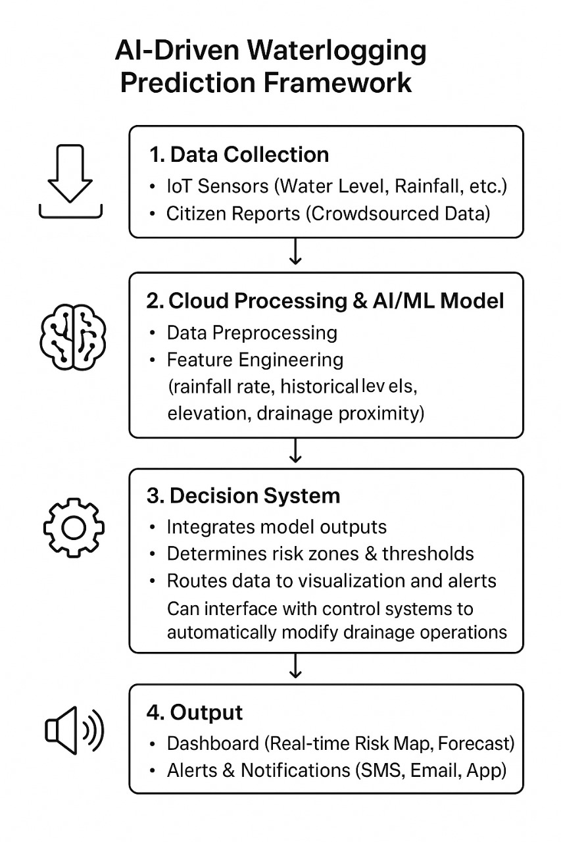
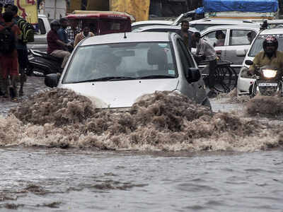
Dr. D. Y. Patil Unitech Society’s
Dr. D. Y. Patil Institute of Technology, Pimpri, Pune
Department of Artificial Intelligence and Data Science
Group No.
47
Title : “AI for Sustainable Urban Drainage System for Effective Waterlogging Prediction and Management”
Student Names: Tushar Chavhan,Sakshi Ingale,Vrushali Dhage,Snehal Godage
Abstract
This project introduces an AI-driven multi-source framework for predicting and managing urban waterlogging.It integrates IoT sensors, GIS-based drainage maps, and real-time meteorological data to provide accurate flood insights.Using Long Short-Term Memory (LSTM) neural networks and ensemble learning, the system analyzes spatial and temporal patterns to predict flooding.Key innovations include real-time updates, edge computing for faster processing, and automated alert systems.The framework supports data-driven decision-making, improves urban resilience, and promotes sustainable city infrastructure.
Objectives
Results and Discussion
To design and develop an AI-based predictive model for waterlogging detection in urban areas
To enable real-time monitoring and automated alerts through smart dashboards and visualization tools.
To optimize drainage management by predicting clogging or overflow conditions in advance.
To reduce urban flood risks by improving the accuracy and speed of predictions.
To support sustainable urban development through intelligent infrastructure planning.
.
To demonstrate scalability and adaptability of the model for various city environments.
The AI-based system achieved over 92% prediction accuracy in identifying potential waterlogging zones.
False alerts were reduced by 5× using multi-source data fusion of IoT, GIS, and weather inputs
The model provided early alerts 2–3 hours before flooding, allowing timely preventive actions.
Visual dashboards helped city officials easily monitor risk areas and take quick decisions.
The framework proved to be cost-efficient, scalable, and suitable for smart city applications.
Overall, the system enhanced urban resilience, reduced flood impact, and supported sustainable drainage management.
Problem Specifications
Problem Statement:
Urban areas face frequent waterlogging due to rapid urbanization, climate change, and inefficient drainage systems.Existing flood prediction models are slow, data-limited, and not real-time.
There is a need for an AI-based integrated system that uses IoT, GIS, and weather data to predict and manage waterlogging effectively.
Methodology
Conclusions
The approach can be scaled to different cities and infrastructure types with minimal modification.
It enhances urban resilience, reduces disaster risk, and supports sustainable development goals
The system provides faster and more accurate decision support, improving response time and minimizing damage.
Edge-based implementation ensures cost-effective, decentralized deployment suitable for smart cities..
Key Challenges:
Integrating IoT, GIS, and weather data in real time
Maintaining data accuracy and reliability.
Ensuring fast, efficient model performance.
Scaling the system for different city infrastructures.
Accurate flood prediction
Fast and reliable response.
References:
[1] D. P. Selvam, G. G. Reddy, and N. M. Kumar, “Designing a Smartand Safe Drainage System using Artificial Intelligence,” InternationalJournal of Engineering Research & Technology (IJERT), vol. 9, no. 11,pp. 497–500, Nov. 2020.
[2] D. Misra, G. Das, and D. Das, “Artificial Intelligent based SmartDrainage System,” Research Square, Feb. 16, 2022. [Online]. Available:https://doi.org/10.21203/rs.3.rs-1338435/v1
[3] P. Huang and K. T. Lee, “An alternative for predicting real-timewater levels of urban drainage systems,” Journal of Environmen-tal Management, vol. 347, p. 119099, 2023. [Online]. Available:https://doi.org/10.1016/j.jenvman.2023.119099
[4] M. Saddiqi, W. Zhao, S. Cotterill, and R. K. Dereli, “Smart managementof combined sewer overflows: From an ancient technology to artificialintelligence,” Journal of Environmental Management, 2023. [Online].Available: https://doi.org/10.1002/wat2.1635

